Slide 1
King Haakon of Norway

Slide 2
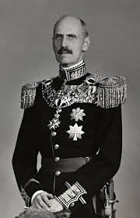
King Haakon was born August 3, 1872 at Charlottenlund Palace in Copenhagen, Denmark,
as Prince Carl of Denmark.

Slide 3
He died September 21, 1957,
at the age of 85,
at the Royal Palace in Oslo, Norway.

Slide 4
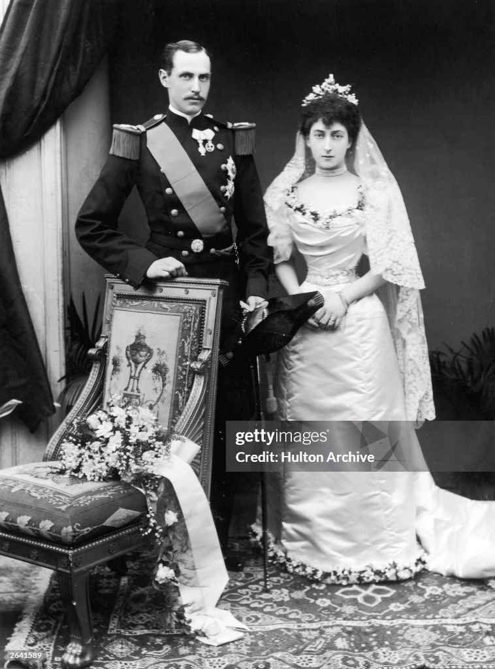
On July 22, 1896, he married his cousin Princess Maud of Wales.

Slide 5
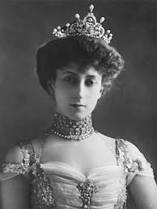
She was born November 26, 1869, at Marlborough House in London.
She died on November 20, 1938, in London

Slide 6
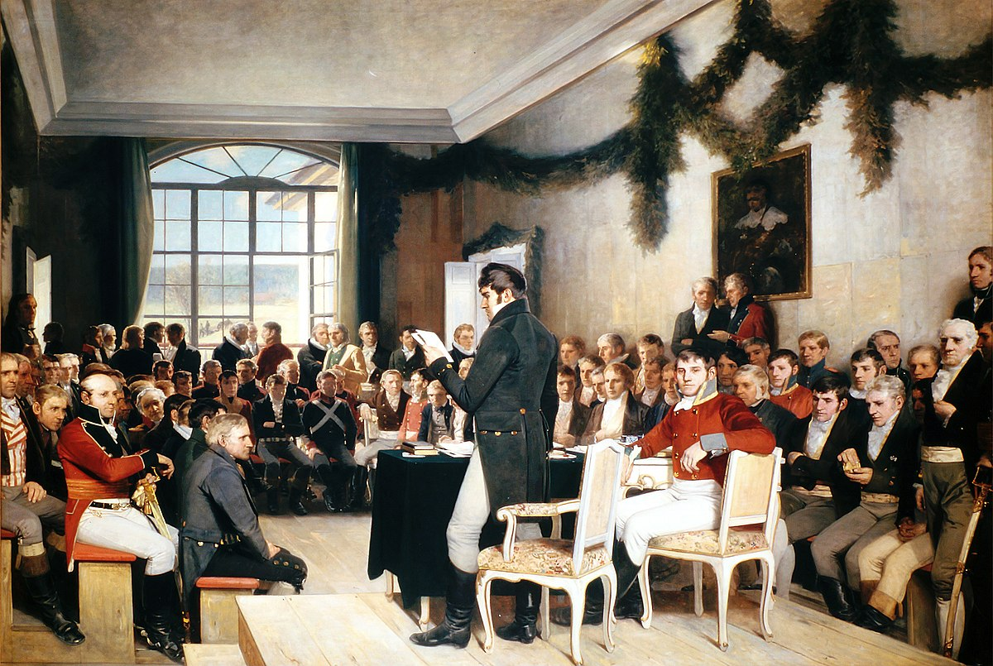
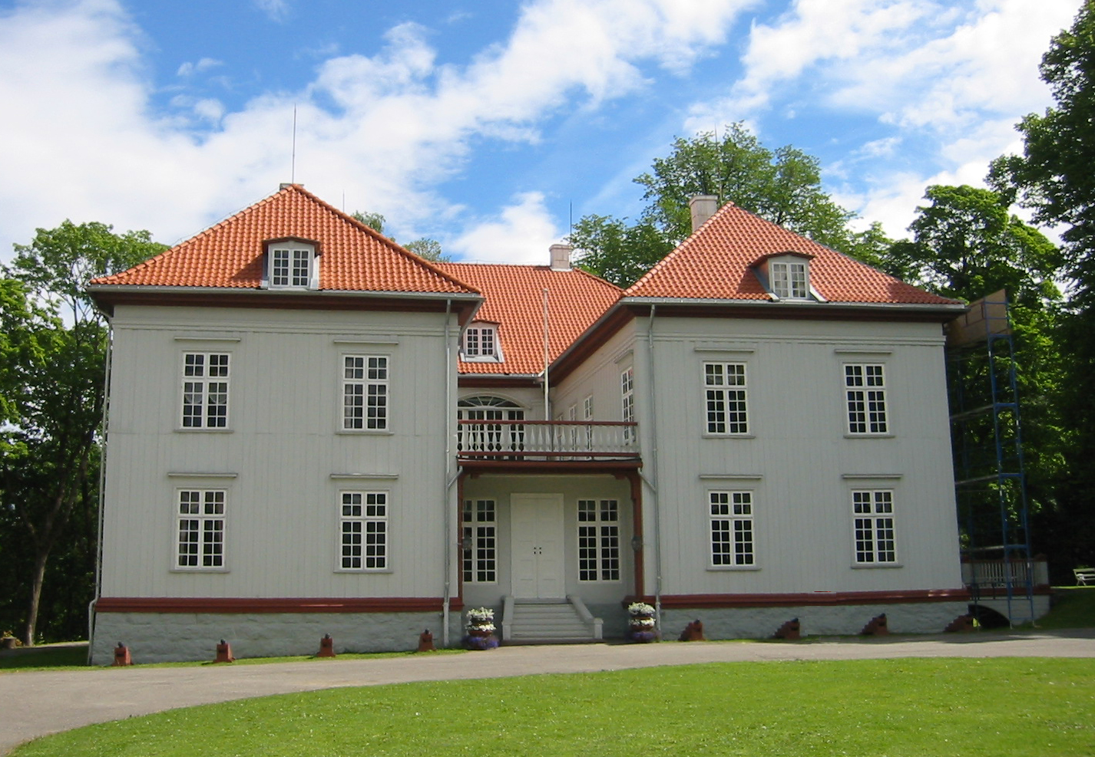
May 17, 1814

Slide 7
May 17, 1814
Norway was under the Danish government from 1537 to 1814

Slide 8
May 17, 1814
Norway was an independent country from May 17 to
August 14, 1814
(November 1814)

Slide 9
May 17, 1814
Because of The Convention of Moss
on August 14, 1814

Slide 10
May 17, 1814
and of The Treaty of Kiel, Norway was ceded to Sweden

Slide 11
May 17, 1814
The Norwegian parliament elected the Swedish king as king of Norway
on November 14, 1814

Slide 12
May 17, 1814
The aftermath of the Napoleonic Wars

Slide 13
1905
Parliament resolution on June 7, 1905

Slide 14
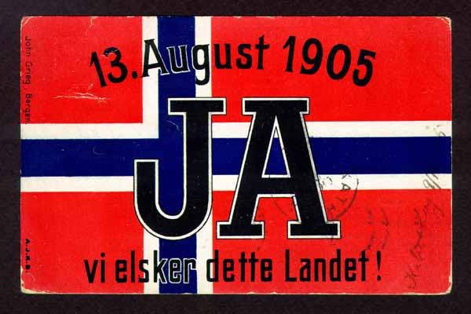
1905
Rerendum held August 13, 1905

Slide 15
1905
Final dissolving of the union
on November 18, 1905

Slide 16
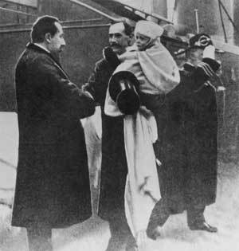
1905
Prince Carl (Haakon)
and his son
Prince Alexander (Olav)
arrive in Norway

Slide 17
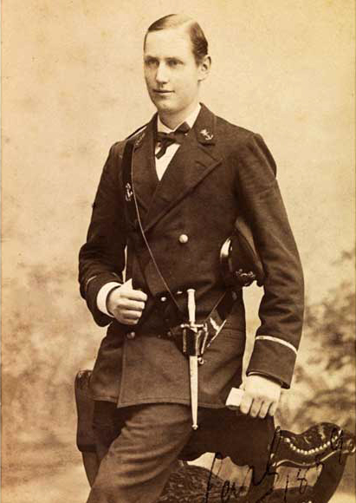
Naval Cadet in 1889

Slide 18
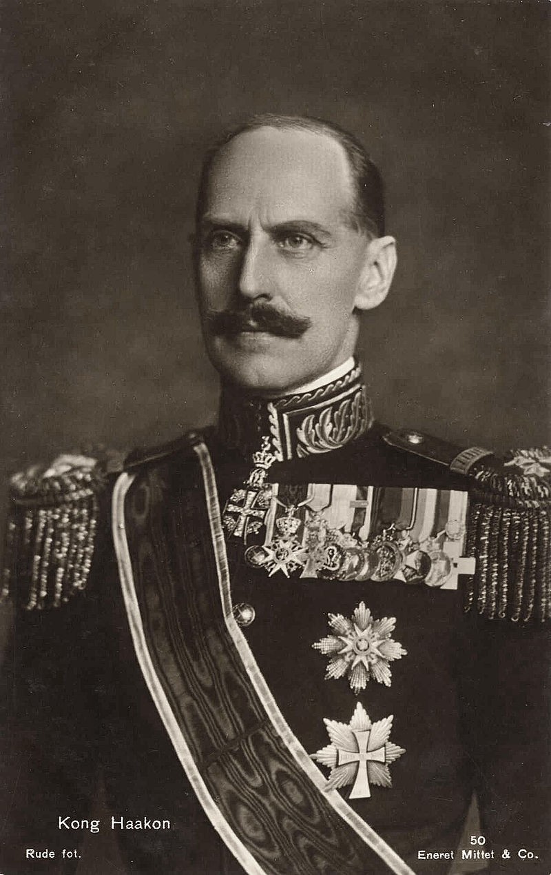
King Haakon in 1930

Slide 19
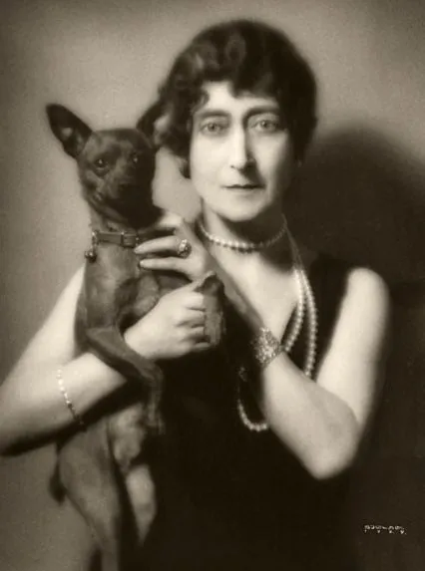
Queen Maud
Dressed according to fashion

Slide 20
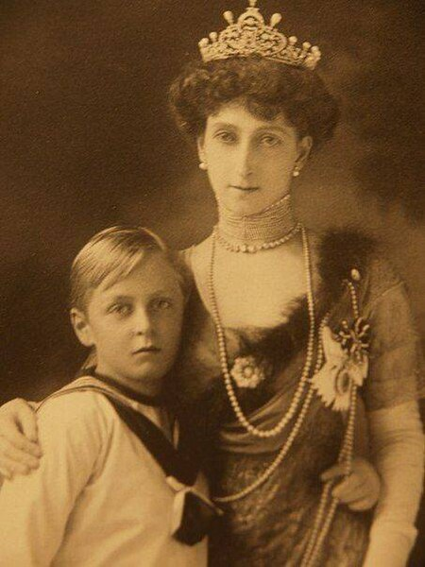
Queen Maud
Dressed according to fashion
and Crown Prince Olav

Slide 21
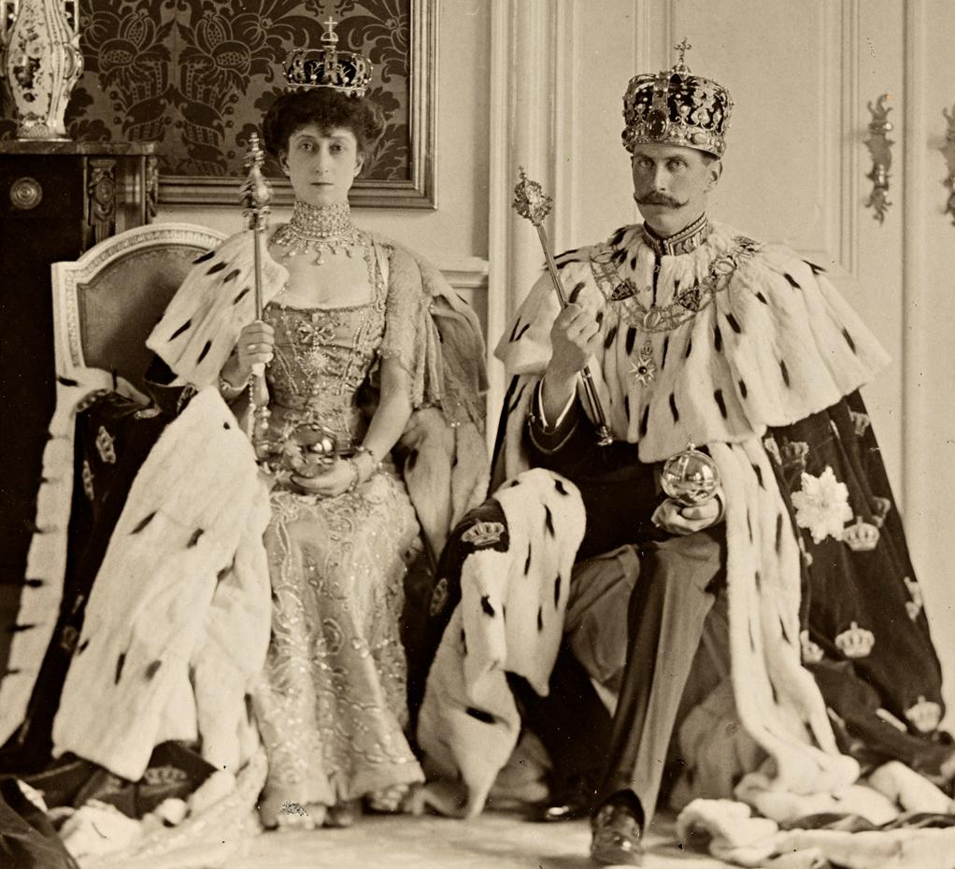
King and Queen
1906

Slide 22
Operation Weserübung

Slide 23
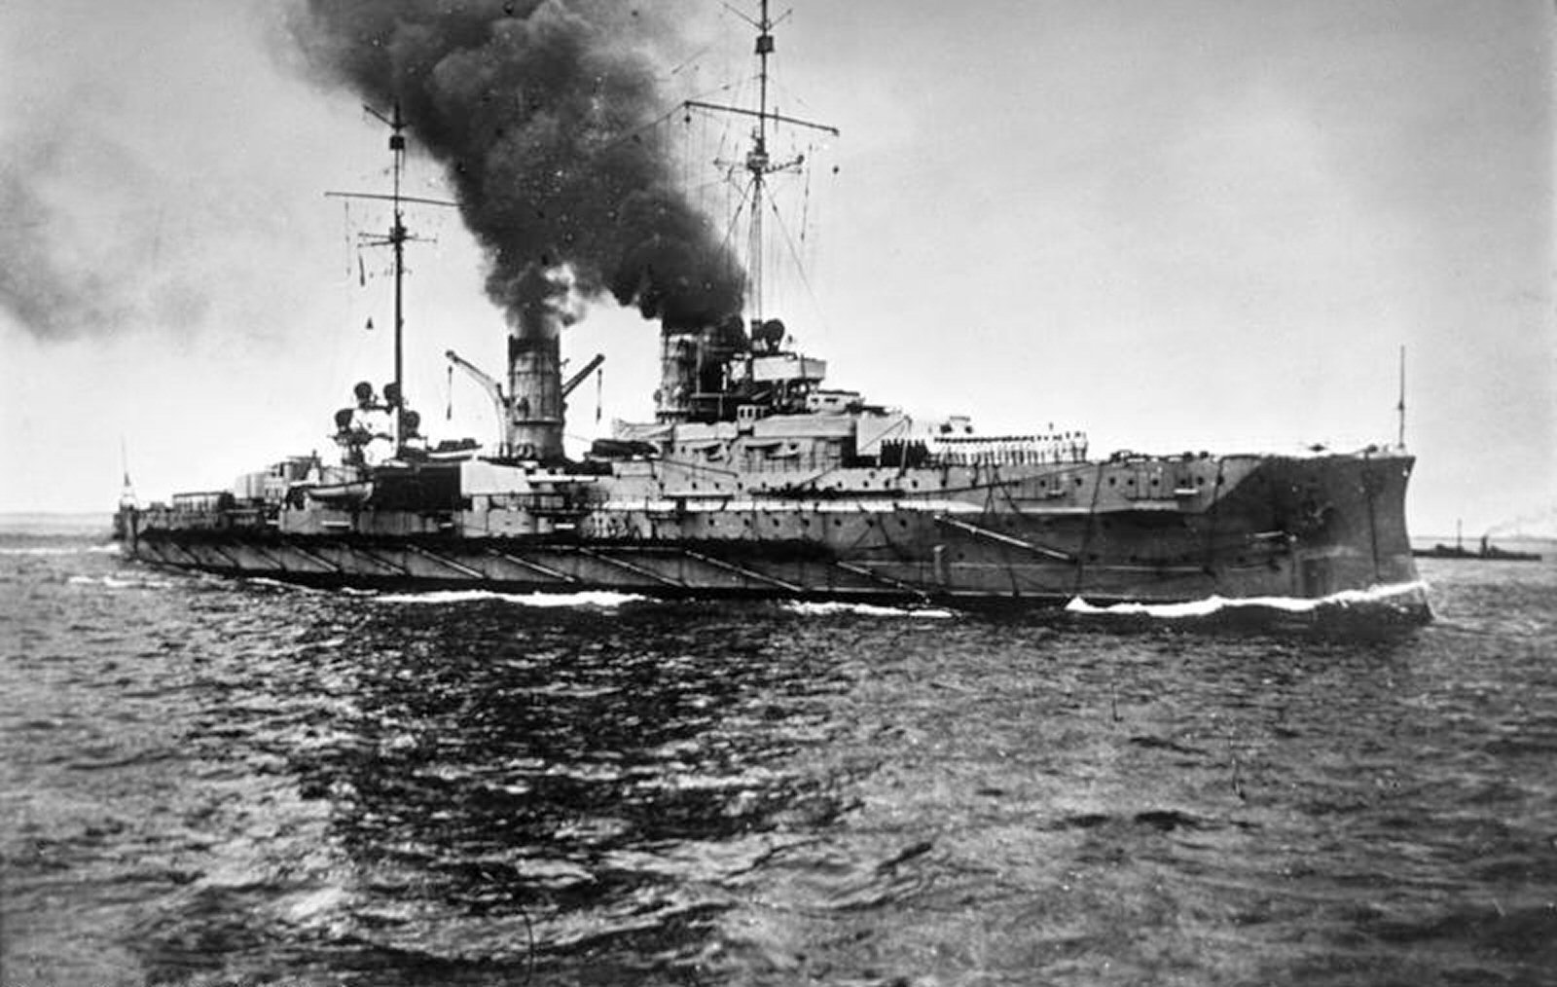
Blücher - April 9, 1940

Slide 24
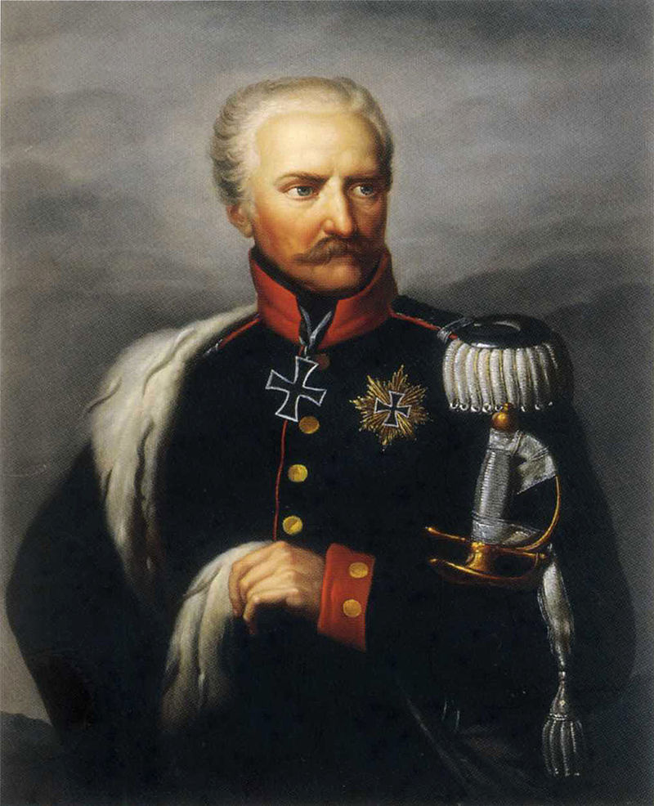
Blücher was the second of five Admiral Hipper-class heavy cruisers of Nazi Germany's Kriegsmarine (lit. 'War Navy'), built after the rise of the Nazi Party and the repudiation of the Treaty of Versailles.
Named for Gebhard Leberecht von Blücher, the Prussian victor of the Battle of Waterloo, the ship was laid down in August 1935 and launched in June 1937. She was completed in September 1939, shortly after the outbreak of World War II.
After completing a series of sea trials and training exercises, the ship was pronounced ready for service with the fleet on 5 April 1940. She was armed with a main battery of eight 203 mm (8 in) guns and, although nominally under the 10,000-long-ton (10,160 t) limit set by the Anglo-German Naval Agreement, actually displaced over 16,000 long tons (16,260 t).

Slide 25
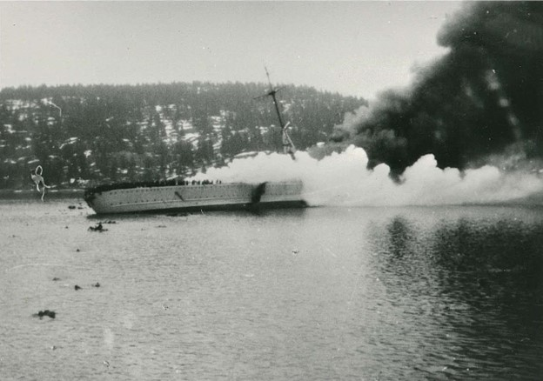
Blücher - April 9, 1940

Slide 26
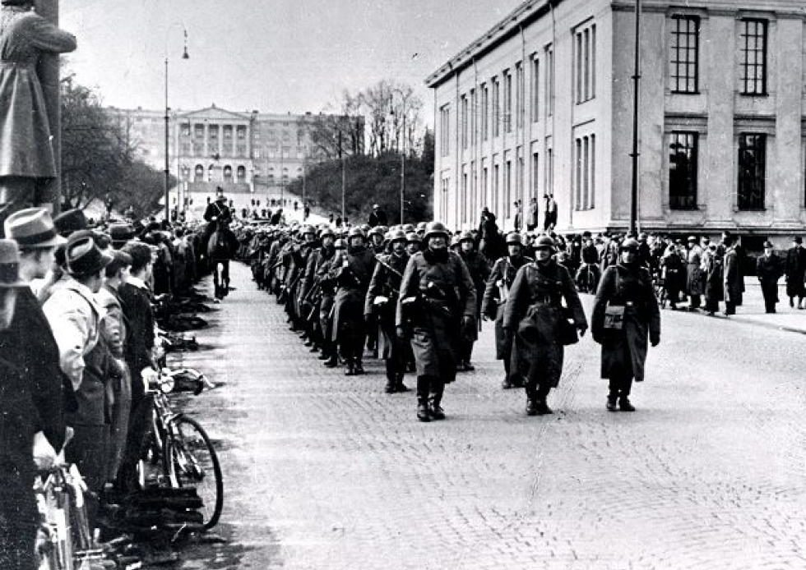
April 9, 1940

Slide 27
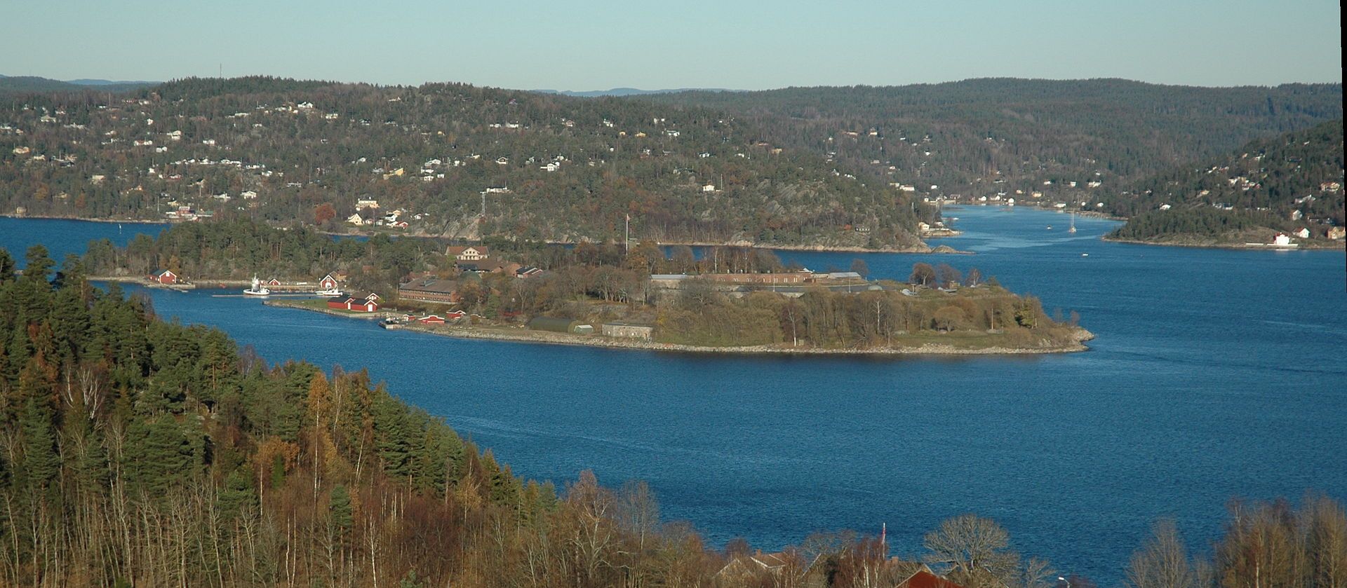
Oscarsborg Fortress

Slide 28
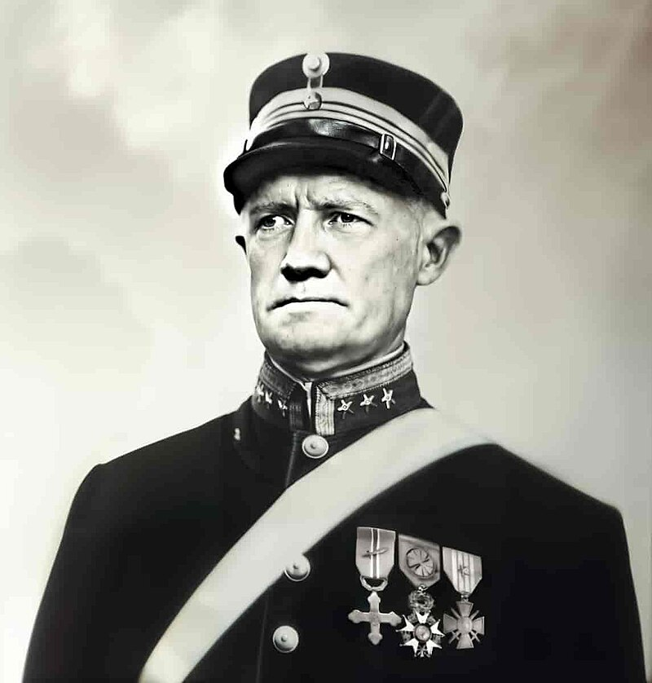
Obert Birger Eriksen
(1875-1958)
He gave the order to stop the ship Blücher.
In the Battle of Drøbak Sound

Slide 29
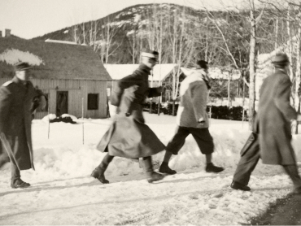
April 9, 1940

Slide 30
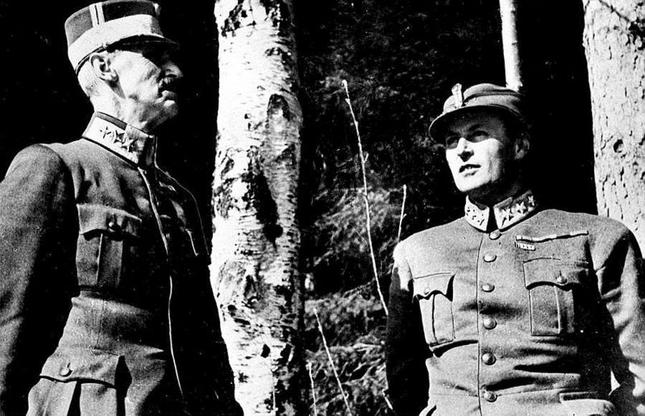
April 9, 1940

Slide 31
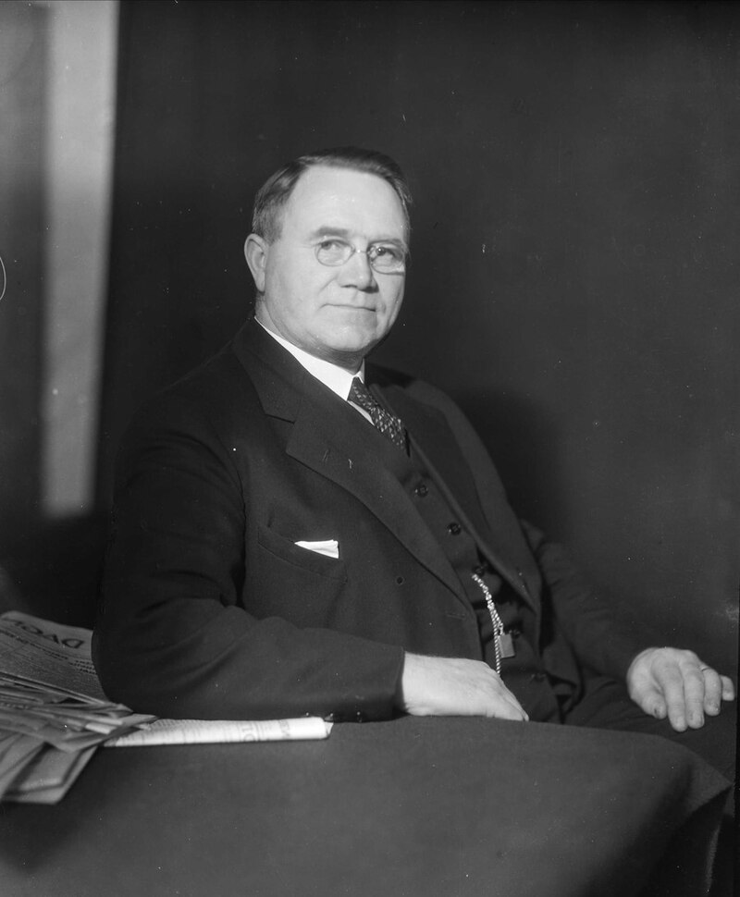
Johan Nygaardsvold
(1879-1952)
Prime Minister of Norway
1935-1945

Slide 32
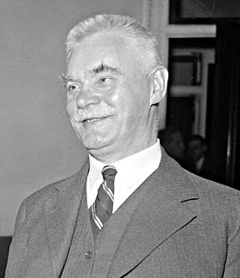
Halvdan Koht
(1873 – 1965)
Norway’s Minister of Foreign Affairs
Mar 20, 1935-Nov.19, 1940

Slide 33
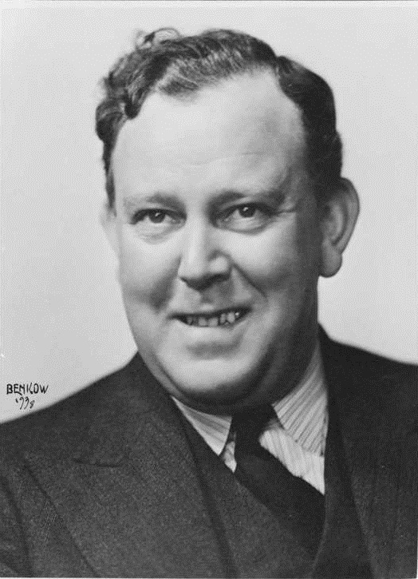
Trygve Lie
(1896-1968)
Minister of Foreign Affairs
Nov.19, 1940 – June 25, 1945
1st Secret-General of the United Nations
1946-1952

Slide 34
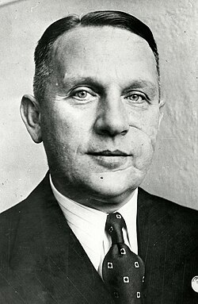
Curt Bräuer
(1889 – 1969)
He was a German career diplomat.
Made envoy to Norway in 1939

Slide 35
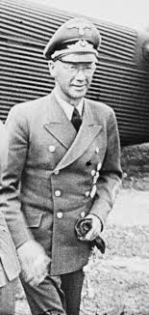
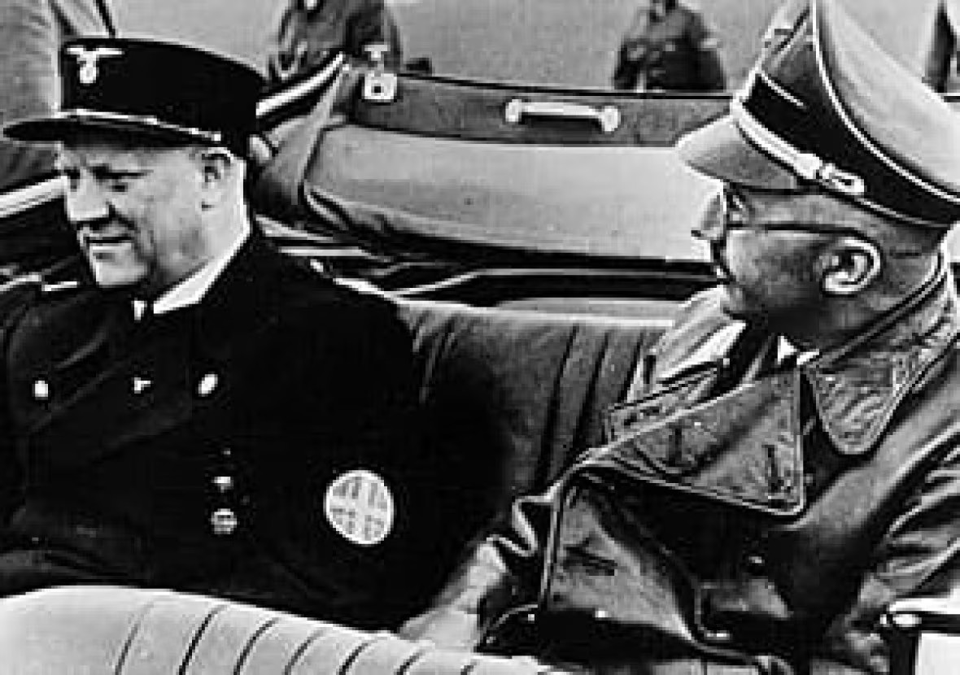
Josef Terboven
Reichskommissar Norwegen

Slide 36
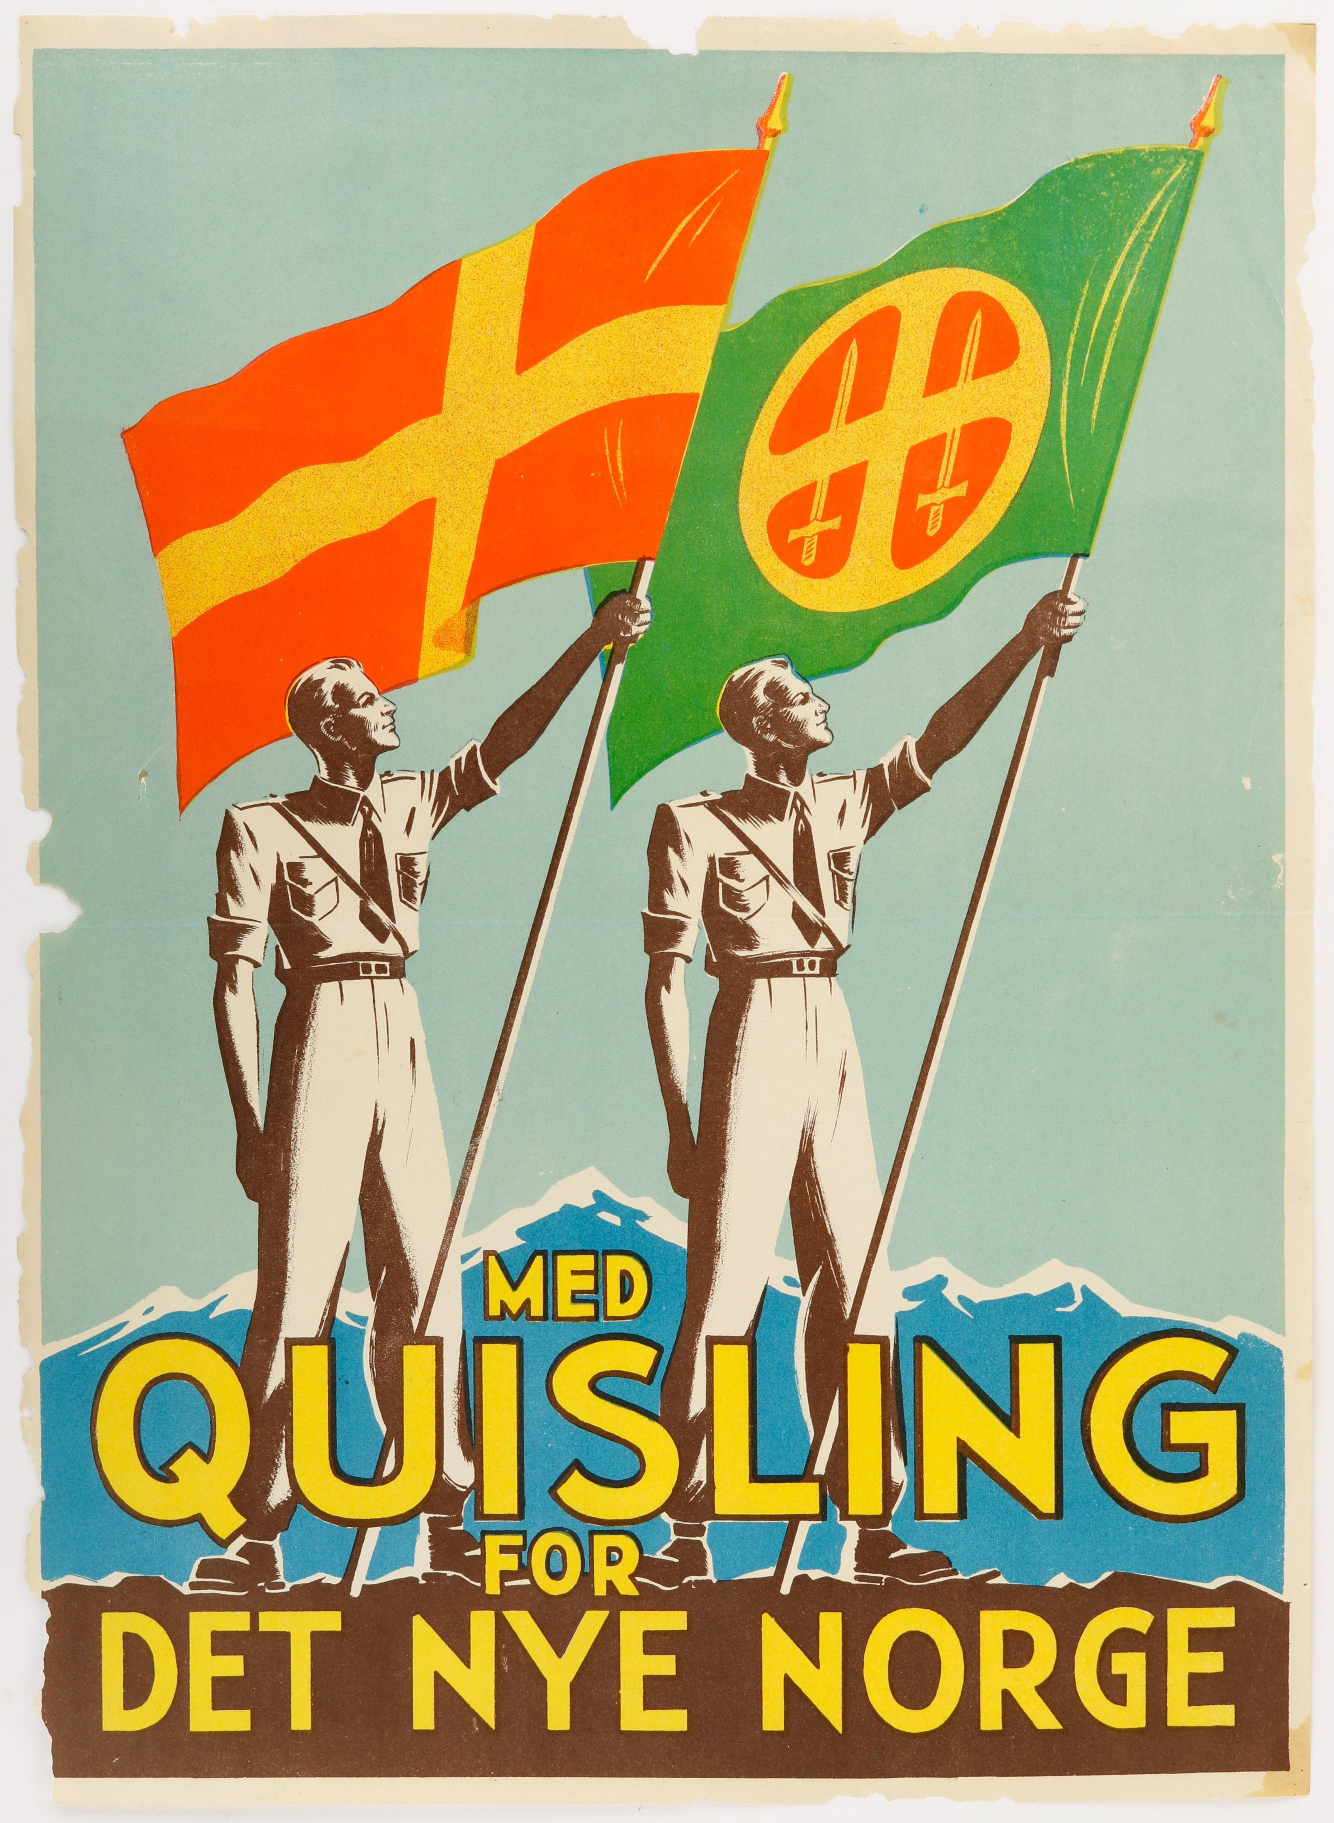
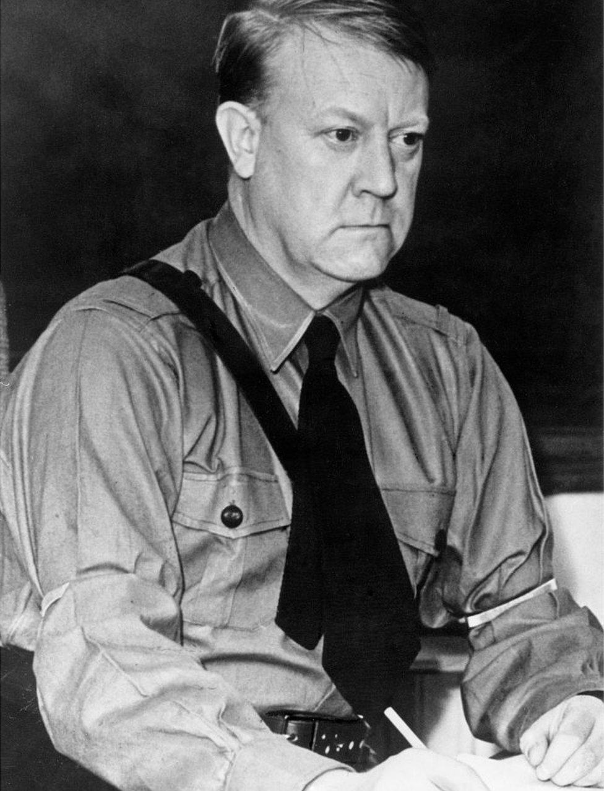
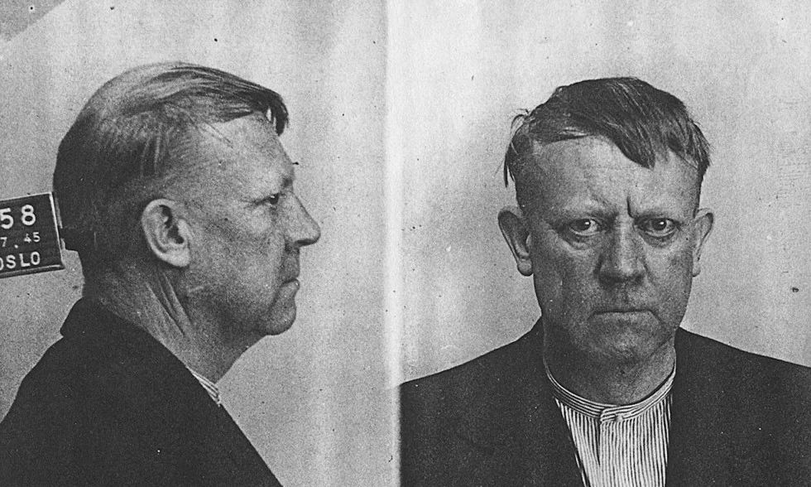
Vidkun Quisling
1887-1945

Slide 37
Norway lost 116 ships
and 1700 lost their lives

Slide 38
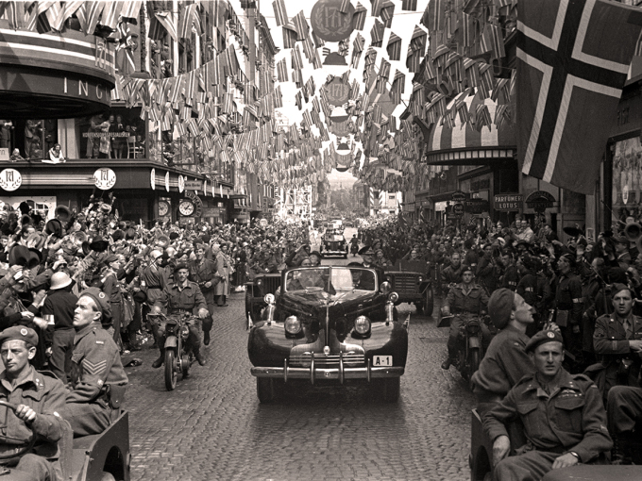
FREEDOM
Buick Roadmaster
Model 1939

Slide 39
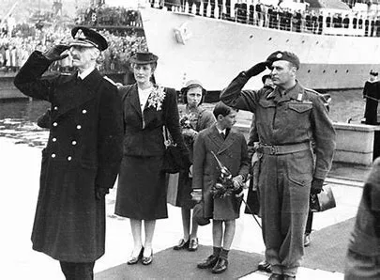
June 7, 1945

Slide 40
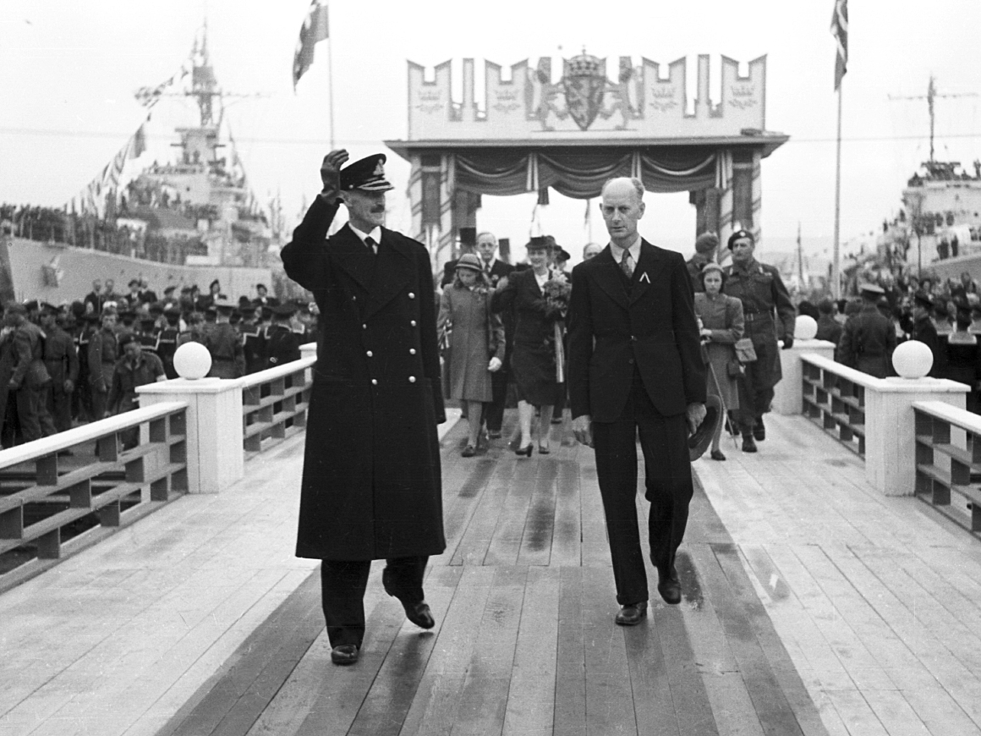
June 7, 1945

Slide 41
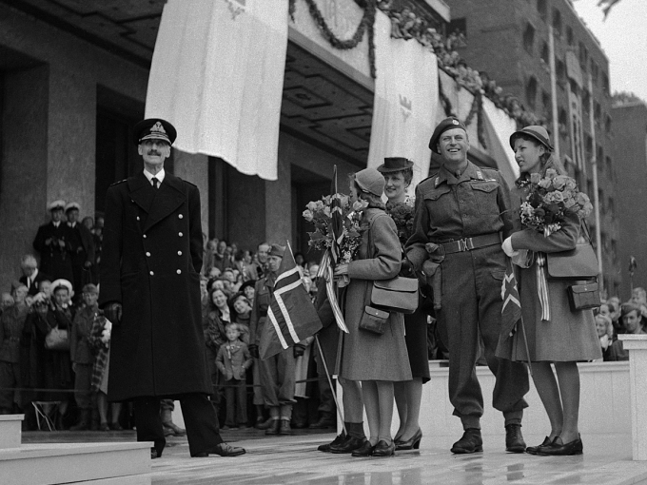
June 7, 1945

Slide 42
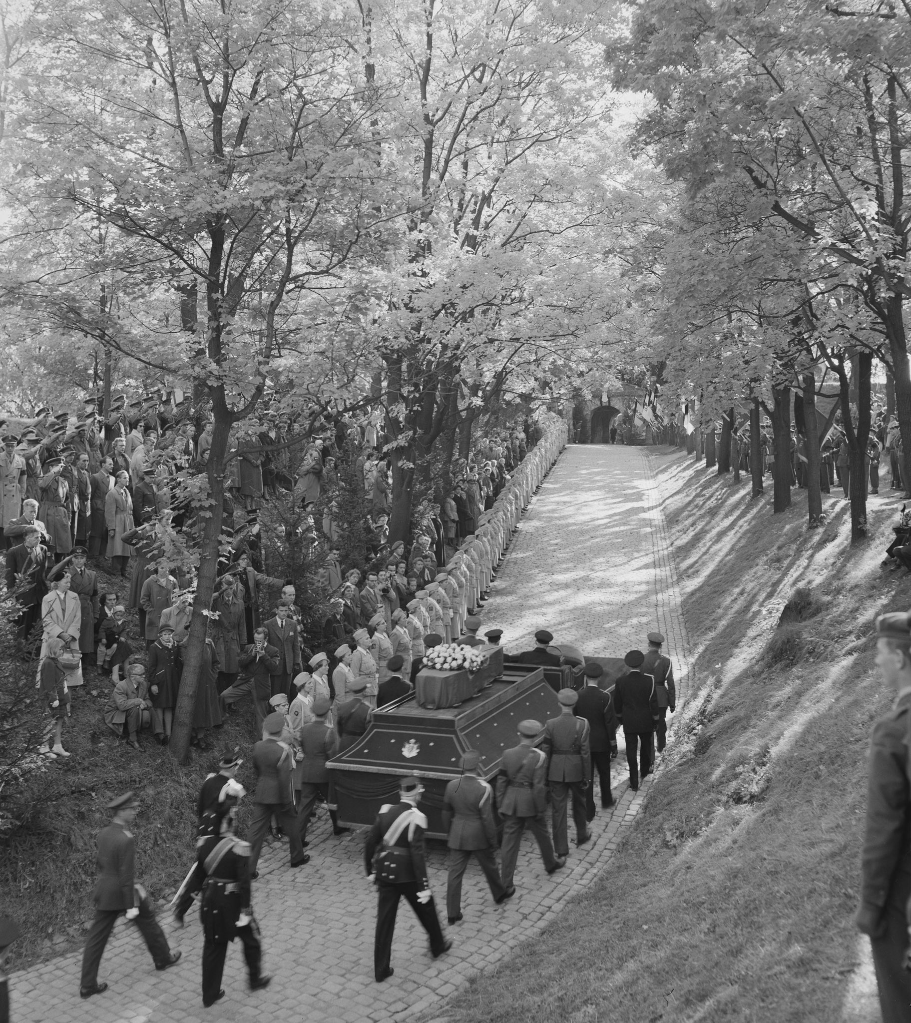
1957

Slide 43
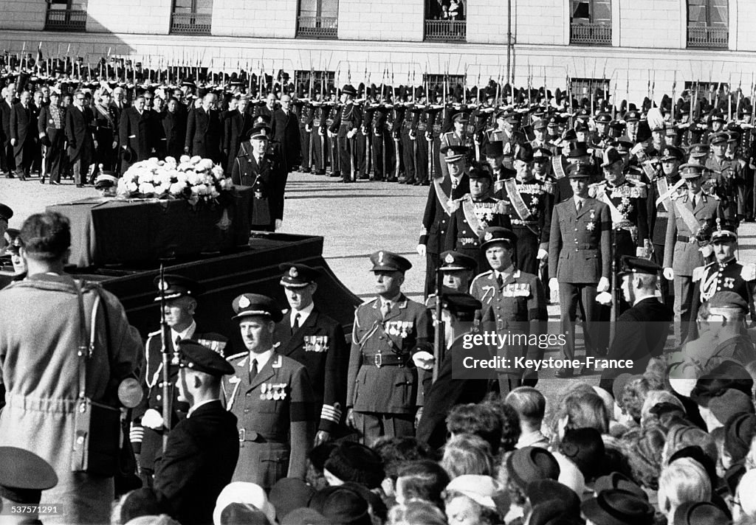
1957

Slide 44
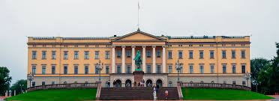
Oslo

Slide 45
Presentation by TJ

